Slide 1
Newtonian Apples 🍎
Adam, Ahmed, Eric, and Jamie

Slide 2

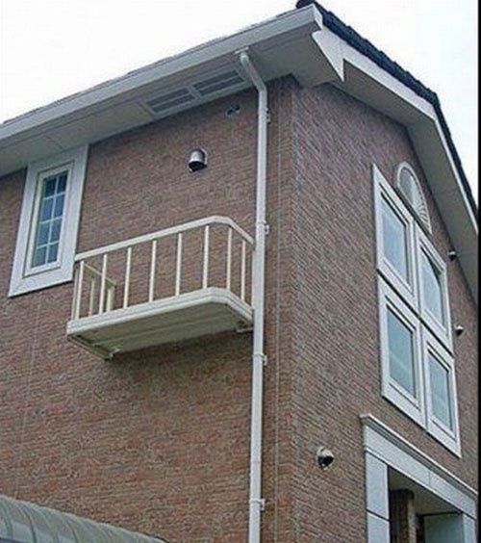



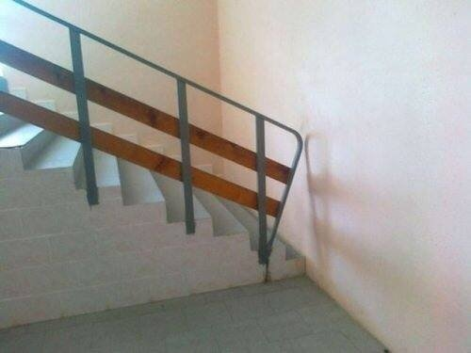
Why physics?

Slide 3
How could we help?
We wanted to create something that would help anyone be able to visualize and intuitively understand physics. Something that would be accessible virtually since we had the pandemic in mind.
So what if we made an app that contained interactive modules that simulated common physics scenarios?
Following our goal of accessible education, we also came up with questions to ask the user to get them reflecting on the scenarios.

Slide 4
How our website works
The goal was to make the website as intuitive and as concise as possible.
We provide a list of descriptions that further help the users to understand what each simulation will cover, how to use it, as well as the benefits of using each simulation.
Under each of the simulation cards created on the website, there are also guidance questions that help users to reflect on their learnings.
The sidebar enable users to navigate between the simulations, as well as traversing back and forth in the web app without any full page refreshes that will torn the user experience.

Slide 5
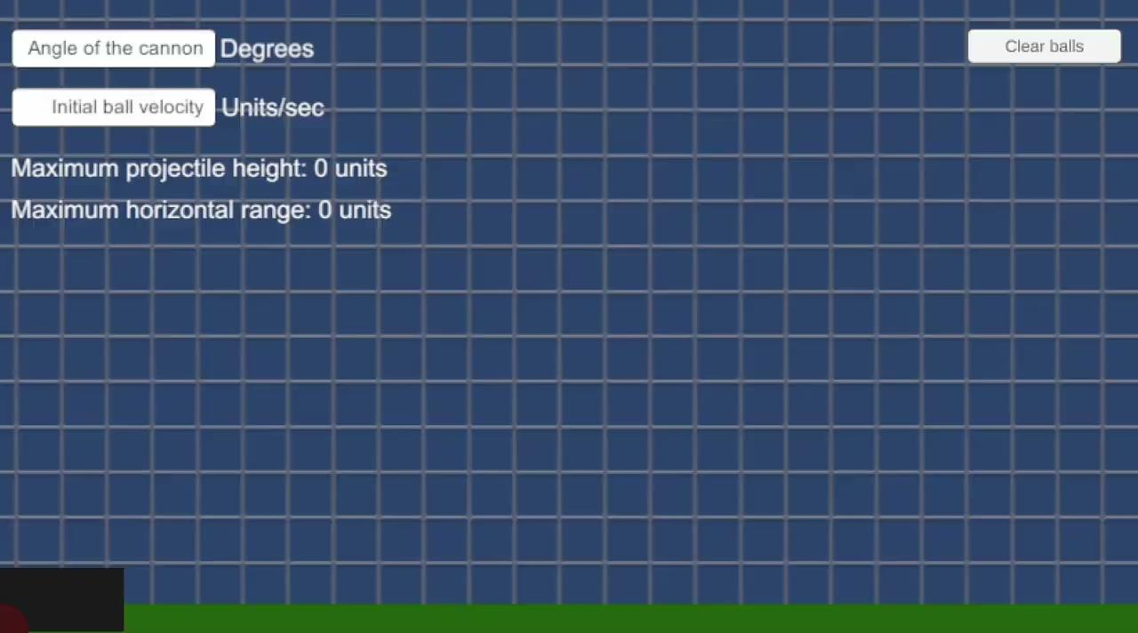
Kinematics

Slide 6
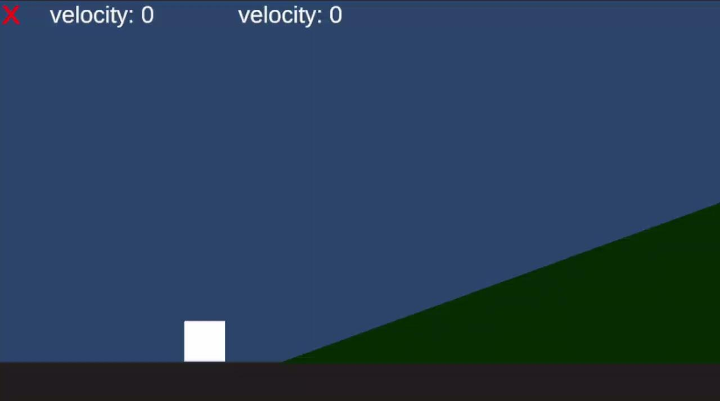
Dynamics

Slide 7
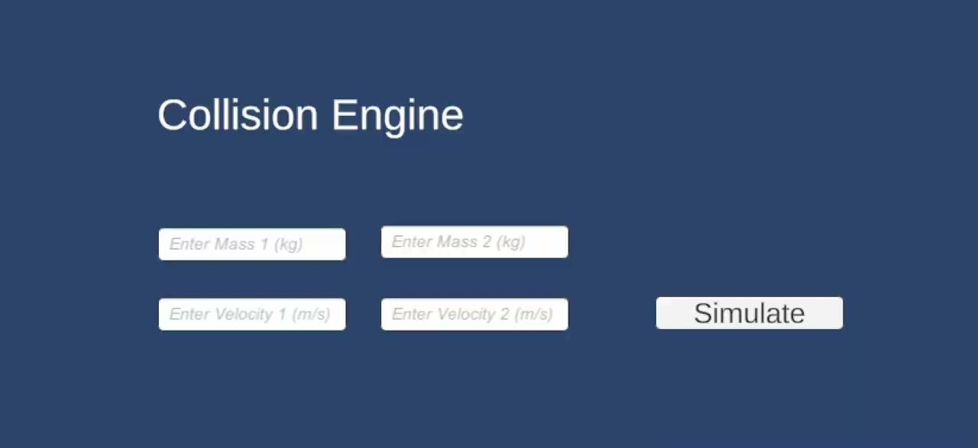
Elastic Collision

Slide 8

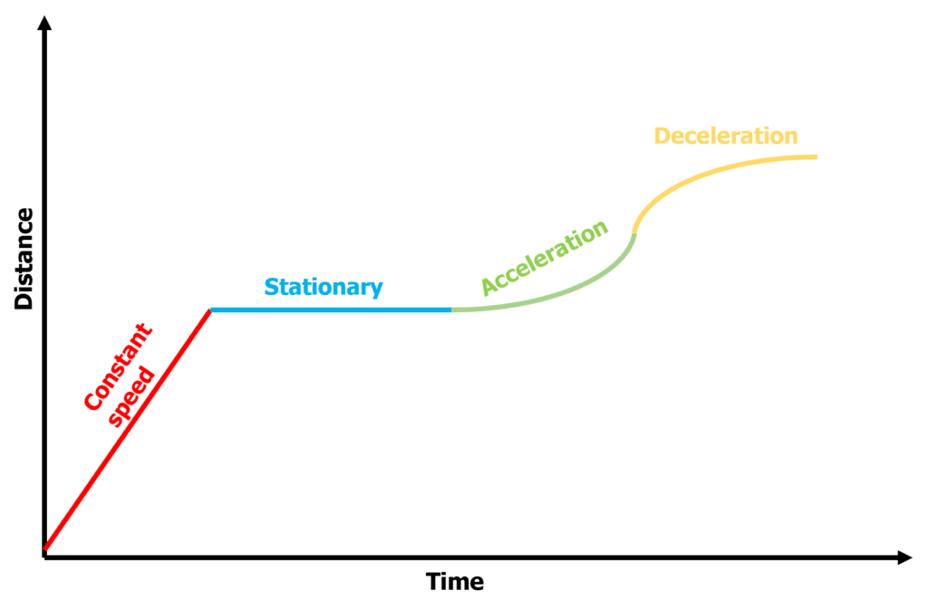
Next Steps

